Slide 1
Friend book A Semantic Based Friend Recommendation System for Social Networks

Slide 2
Abstract
Existing social networking services recommend friends to users based on their social graphs, which may not be the most appropriate to reﬂect a user’s preferences on friend selection in real life. In this paper, we present Friend-book, a novel semantic-based friend recommendation system for social networks, which recommends friends to users based on their life styles instead of social graphs. By taking advantage of sensor-rich smart-phones, Friend-book discovers life styles of users from user-centric sensor data, measures the similarity of life styles between users, and recommends friends to users if their life styles have high similarity. Inspired by text mining, we model a user’s daily life as life documents, from which his/her life styles are extracted by using the Latent Dirichlet Allocation algorithm. We further propose a similarity metric to measure the similarity of life styles between users, and calculate users’ impact in terms of life styles with a friend-matching graph.

Slide 3
We further propose a similarity metric to measure the similarity of life styles between users, and calculate users’ impact in terms of life styles with a friend-matching graph. Upon receiving a request, Friend-book returns a list of people with highest recommendation scores to the query user. Finally, Friend-book integrates a feedback mechanism to further improve the recommendation accuracy. We have implemented Friend-book on the Android-based smart-phones, and evaluated its performance on both small-scale experiments and large-scale simulations. The results show that the recommendations accurately reﬂect the preferences of users in choosing friends.

Slide 4
Existing System
Most of the friend suggestions mechanism relies on pre-existing user relationships to pick friend candidates. For example, Facebook relies on a social link analysis among those who already share common friends and recommends symmetrical users as potential friends. The rules to group people together include:
Habits or life style
Attitudes
Tastes
Moral standards
Economic level; and
People they already know.
Apparently, rule #3 and rule #6 are the mainstream factors considered by existing recommendation systems.

Slide 5
Disadvantages
Existing social networking services recommend friends to users based on their social graphs, which may not be the most appropriate to reflect a user’s preferences on friend selection in real life

Slide 6
Proposed System
A novel semantic-based friend recommendation system for social networks, which recommends friends to users based on their life styles instead of social graphs.
By taking advantage of sensor-rich smart-phones, Friend-book discovers life styles of users from user-centric sensor data, measures the similarity of life styles between users, and recommends friends to users if their life styles have high similarity.
We model a user’s daily life as life documents, from which his/her life styles are extracted by using the Latent Dirichlet Allocation algorithm.
Similarity metric to measure the similarity of life styles between users, and calculate users’
Impact in terms of life styles with a friend-matching graph.
We integrate a linear feedback mechanism that exploits the user’s feedback to improve recommendation accuracy.

Slide 7
Advantages
Recommendeds potential friends to users if they share similar life styles.
The feedback mechanism allows us to measure the satisfaction of users, by providing a user interface that allows the user to rate the friend list

Slide 8
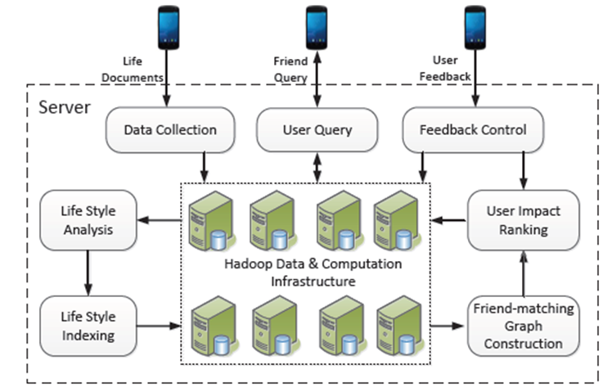
Architecture Diagram

Slide 9
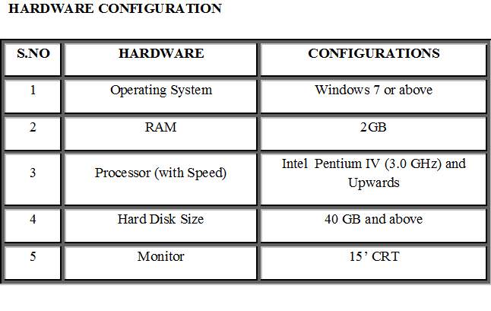
SYSTEM CONFIGURATION

Slide 10
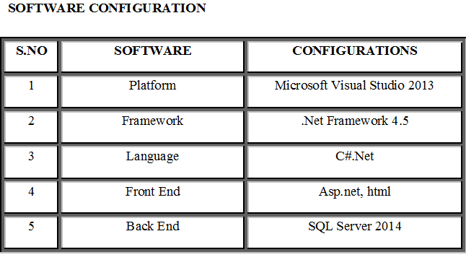

Slide 11
Modules
1. Server Module
2. User Module
3. Life Style Indexing Module
4. Data Collection Module
5. User Query Module
6. Feedback Control Module
7. User Impact Ranking Module
8. Friend-Matching Graph Construction Module

Slide 12
1. Server Module
Server controls all the functionalities of the users such as their interaction data collection, etc.,
2. User Module
User receives the requests from the various Users without their personal interaction based on the life style matching. The User can have conversation by putting some questions before accepting the request then he may accept/reject the request.
3. Life Style Index Module
life styles and activities are reflections of daily lives at two different levels where daily lives can be treated as a mixture of life styles and life styles as a mixture of activities. This is analogous to the treatment of documents as ensemble of topics and topics as ensemble of words.

Slide 13
4. Data Collection Module
In this module the server collects the life documents related to the users for finding the similarities between the users and send the requests to the activity matching life style of other user.
5.User Query
Before a user initiates a request, he/she should have accumulated enough activities in his/her life documents for efficient life styles analysis. The period for collecting data usually takes at least one day. Longer time would be expected if the user wants to get more satisfied friend recommendation results. After receiving a user’s request (e.g., life documents), the server would extract the user’s life style vector, and based on which recommend friends to the user.

Slide 14
6. Feedback Control Module
After the server generates a reply in response to a query, the feedback mechanism allows us to measure the satisfaction of users, by providing a user interface that allows the user to rate the friend list.
7. User Impact Ranking Module
The friend-matching graph has been constructed to reflect life style relations among users. However, we still lack a measurement to identify the impact ranking of a user quantitatively. Intuitively, the impact ranking means a user’s capability to establish friendships in the network. In other words, the higher the ranking, the easier the user can be made friends with, because he/she shares broader life styles with others.
8. Friend-Matching Graph Construction Module
Based on the similarity metric, we model the relations between users in real life as a friend-matching graph.

Slide 15
CONCLUSIONS
In this paper, we presented the design and implementation of Friendbook, a semantic-based friend recommendation system for social networks. Different from the friend recommendation mechanisms relying on social graphs in existing social networking services, Friendbook extracted life styles from user-centric data collected from sensors on the Smartphone and recommended potential friends to users if they share similar life styles. We implemented Friendbook on the Android-based smart phones, and evaluated its performance on both small-scale experiments and large-scale simulations. The results showed that the recommendations accurately reﬂectthepreferencesofusersinchoosingfriends.

Slide 16
The end,thank you!

